Slide 1
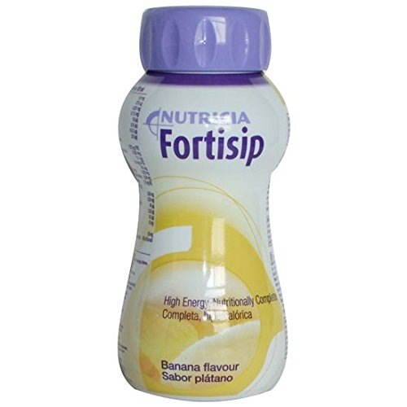
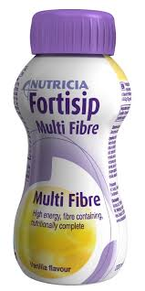
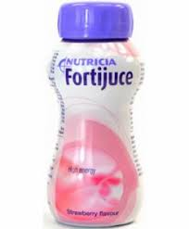
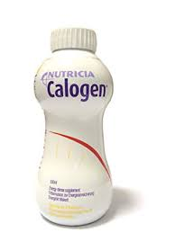
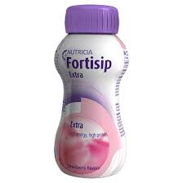
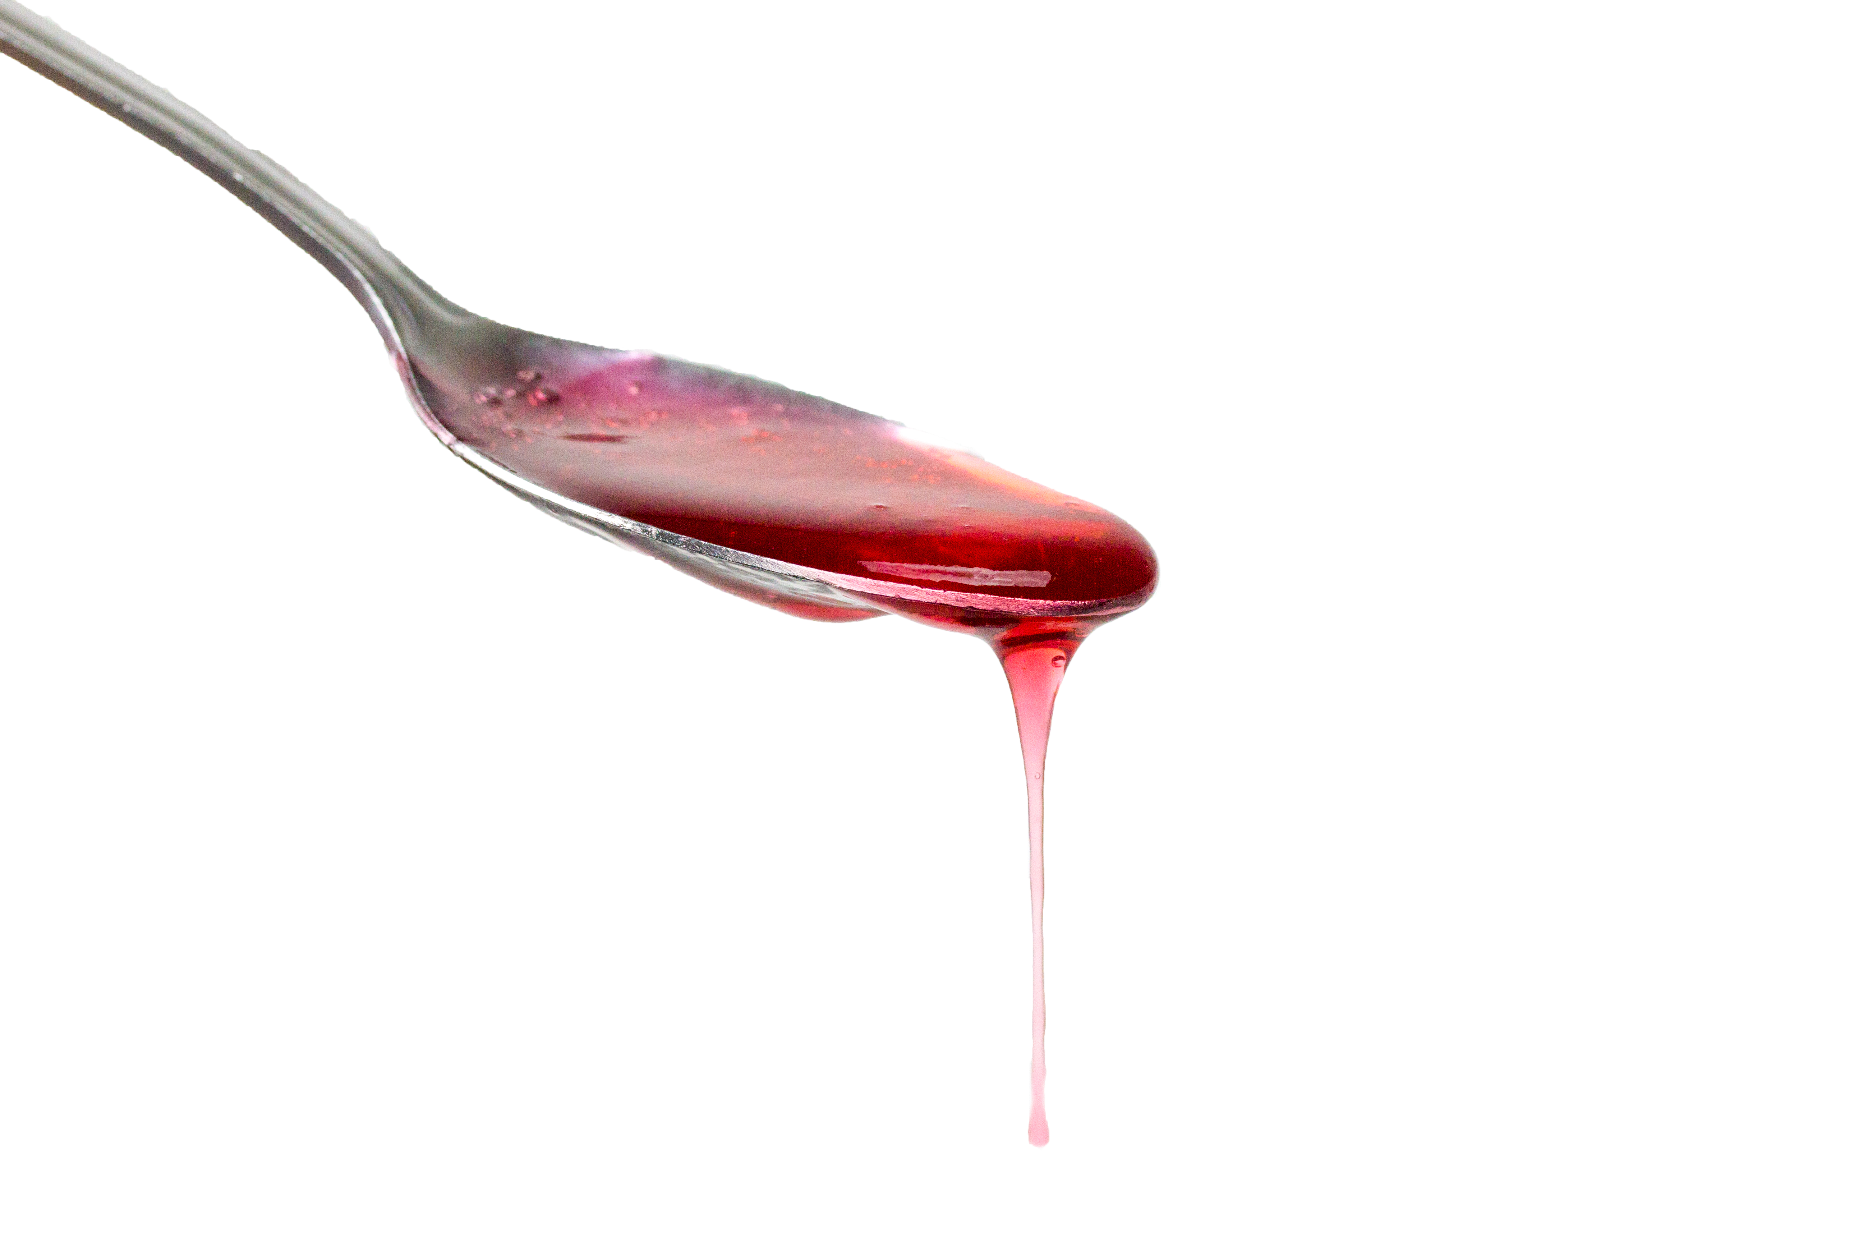
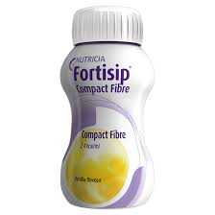
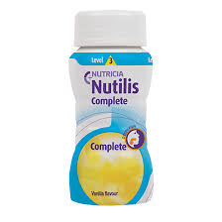
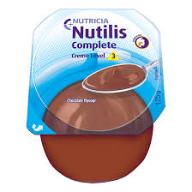
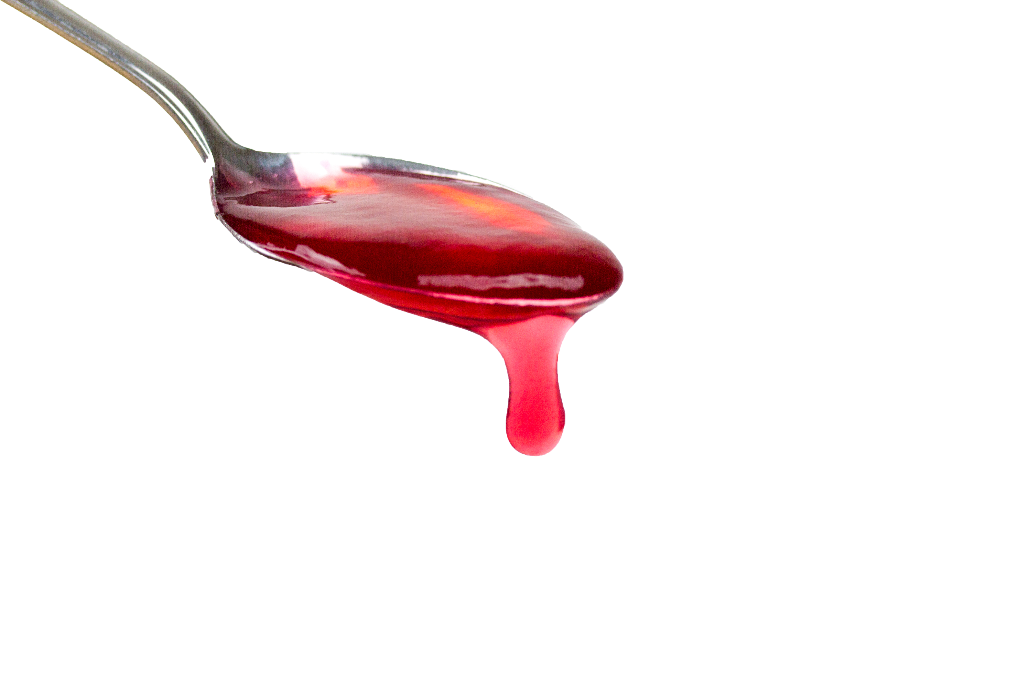
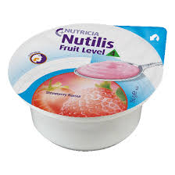
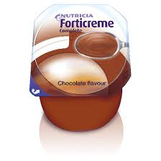
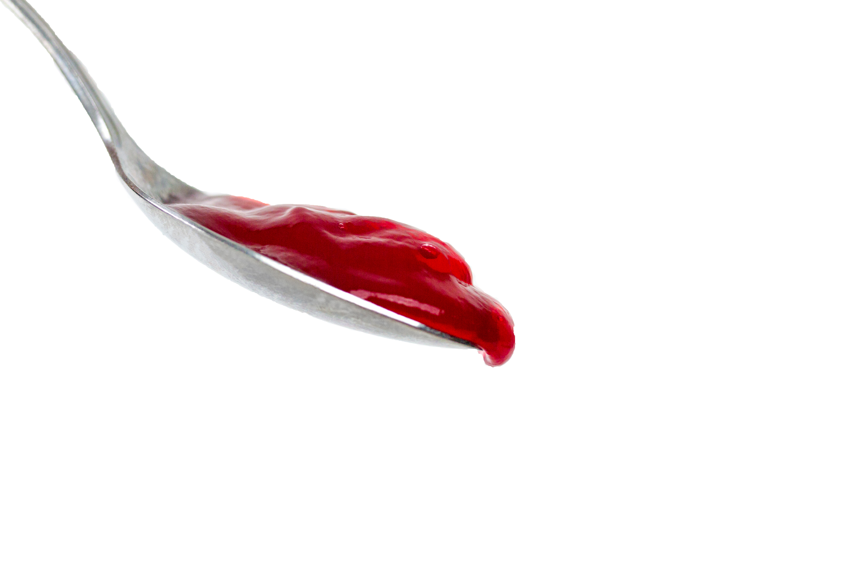
Are you prescribing the correct thickness of supplement??
DO NOT!!!
Modify these supplements with thickener
Fortisip Bottle
Fortisip Multi Fibre
Fortijuce
Calogen
Level 1: Slightly thick
Fortisip Extra*
Level 2: Mildly thick
Fortisip Compact
Fibre*
Level 3: Moderately thick
Nutilis Complete
Drink
Nutilis Complete
Creme
Level 4: Extremely thick
Nutilis Fruit
Forticreme
Complete
Independently engineer tested in controlled laboratory environment.
*Indicative IDDSI level. Due to manufacturing reasons some variation between flavours and batches may be observed

