Slide 1


Financial Support Available to NHS Staff
Interactive guide

Slide 2
Purpose of this document
This is a clickable guide to the support available with the key information about eligibility and what is needed to make the application at your fingertips
The purpose is to save time clicking through to web pages and reading about schemes which are restricted to particular groups, unless you are a member of the group in question

Slide 3
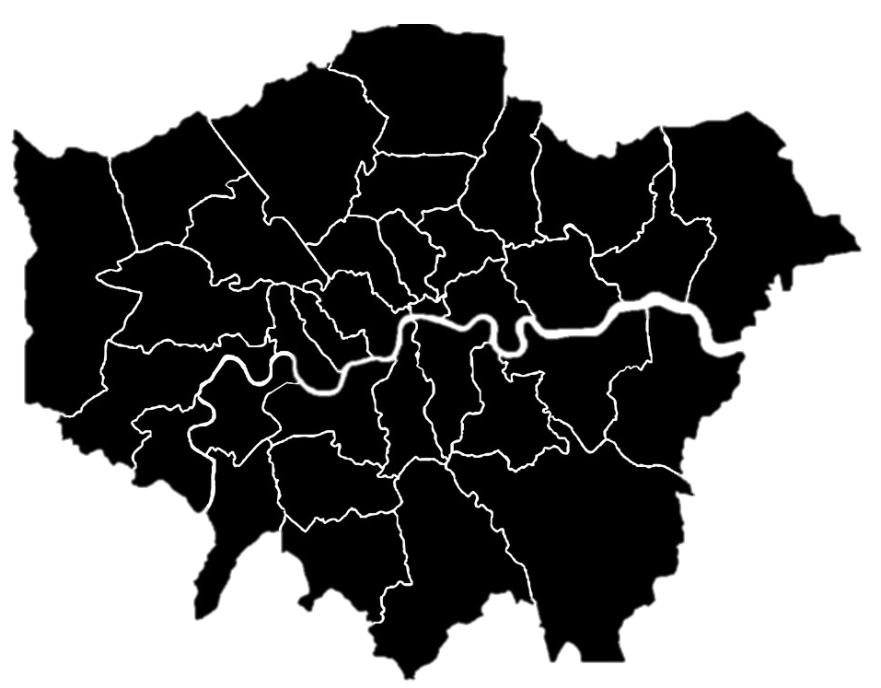


Support available to everyone
A self-guided tool to help you maximise your income.
Over 220 useful links to take you straight to the free help and support you may need.
Ranges from benefits, housing assistance to free debt advice
IncomeMax Bounce Back
Check List
Click here for the checklist
Information for Londoners
Grant information
Fuel
Childcare
Discounts
Click these links to more information in this document
NHS Specific Discounts

Slide 4
Specific Support
I am…
Nurse/Midwife
Nursing or Midwifery Support Worker
Nursing Student
Doctor
Medical Student
Healthcare Student
Ambulance Worker
Working on behalf of my colleagues
Interested in help for someone outside the NHS

Slide 5
Support Available
What you can access and where to go to do so

Slide 6


The Government ‘Help for Households’ portal has information on payments and other support available
Support available to all staff
Some offers available to all customers, not just those in arrears
Fuel – click on the logo to go to the site
Octopus Energy
Customer Support Fund
Free electric blankets for the vulnerable
Scottish Power
Support to pay Scottish Power debt
Hardship Fund for recipients of certain benefits, low income, or special circumstances
Shell
Access to support fund
Loan of thermal imaging camera
Contact directly
Apply after contacting recognised debt agency
Apply via Sigma Connected Support
Contact directly
E●On Next
Support fund for those in hardship or struggling
Grant to help with energy debt
Grant for replacement appliance
Have to show commitment to achieving financial stability
Apply through https://www.lets-talk.online/
EDF
Customer Support Fund for those on Priority Services Register
bulb
Currently closed due to high demand
OVO Energy
Direct Financial Relief
Hardship Scheme
British Gas Energy Trust
Eligible Customers can apply for grants £250-£1500
Need to show money advice has been sought
Seek independent advice before applying
Apply via https://forms.lets-talk.online/Login
Apply to British Gas Energy Trust
Specialist support
Free and discounted products and services available to all customers
Contact Direct
Apply direct

Slide 7
Support available to all staff
The Government ‘Help for Households’ portal has information on payments and other support available
Childcare
Other costs
Tax-free childcare
You can get up to £500 every 3 months (up to £2,000 a year) for each of your children to help with the cost of childcare
30 hours free childcare
Eligible working families in England with 3 and 4 year old children can receive 30 hours of free childcare a week.
You may be able to claim back up to 85% of your childcare costs if you’re eligible for Universal Credit, with up to £646 back each month for one child or £1,108 for 2 or more children
15 hours free childcare
Families in England who have 2 year old children and are on certain benefits can get 15 hours of free childcare a week.
Child Benefit
You can claim Child Benefit if you’re responsible for bringing up a child who is:
Claim back childcare costs
All families with children aged 3 and 4 can also access 15 hours of free childcare a week.
under 16
under 20 if they stay in approved education or training
Free school meals
Free school meals are available to pupils in England if parents get certain benefits
Holiday activities and food programme
You can get access to free activities and food for your children in the holidays if they receive free school meals
You could claim a one-off payment of £500 to help towards the costs of having a child
National Breakfast Clubs
All participating schools will receive a 100% subsidy for breakfast club provision until the end of July 2023
Healthy Start vouchers
If you’re more than 10 weeks pregnant or have a child under 4, you may be able to get help to buy healthy food and milk
Help with maternity costs
Apply via your Local Authority

Slide 8



Support available to everyone
Blue Light Card
Fuel
3-6p per litre saving
Retail Discounts
Range of discounts 5-50% or special offers
Online retailers
Gift Card Discounts
Pre-purchase discounted gift voucher
Can view spend so can track for expenses
Linked to a card so payment is taken automatically
Eg 10% discount
Purchase £100 gift card for £90
Spend £100 in store
Spend in retailers for full amount
Restaurants and other high street services
Leisure activities
Household services
On 30mpg equates to 0.5p per mile saving
What do I need to know?
  £4.99 for 2 years
  Online application
  Around 5 minutes to apply
  Documentation required
  Photo of ID card OR
  Payslip (photo or download)
  Uploaded into the application form from a file

Slide 9

Healthcare Workers Foundation
What do I need to know?
  Online application
  Around 20-30 minutes to apply
  Information required
Your role - including official photo ID (including date of issue if applicable)
Marital status
Dependents
Housing status
Disability
Benefits
Supporting evidence
annual household income
full and latest bank statement (covering at least a calendar month) for every account including partner’s
Include savings and Pay Plan accounts, as well as ISAs
General Fund – link to the item required
Apply here
Cover the physical, mental and day-to-day needs of all healthcare workers, from doctors and nurses to cleaners and porters
Rainy Day Fund
Up to £250 for healthcare workers struggling financially
You can use it in any way useful. Once approved, the amount will be awarded directly bank account
General Fund
Grant of up to £1,000 towards a specific cost for those experiencing financial difficulty
Only apply for one item
I am working on behalf of my colleagues
The CSIS Charity Fund awards grants to charities working with public sector organisations
Contact them to see if your charity is eligible for a grant

Slide 10
Help for specific staff groups

Slide 11




Nurse/Midwife
Nursing or Midwifery Support Worker
What do I need to know?
  Online application
  Around 20-30 minutes to apply
  Detailed breakdown of all household income and outgoings
  Documentation required
  Evidence of your qualifying employment
  Benefits letters for you and any partner
  Bank statements for you and any partner
  Quotes / estimates for any specific items
Who it’s for
Registered nurse, nursing associate or midwife
Eligibility
Living in the UK
Help with
Short term financial emergencies
Maternity support worker
Health care assistant / nursing auxiliary in a hospital, nursing home or community setting
Have less than £4,000 in savings
Be in financial hardship
Essential white goods
Travelling expenses for attending medical treatment
Mobility aids
Home adaptations due to disability
Help with
cont…
Rent deposits and removal costs
Bankruptcy and Debt Relief Order fees
Rent arrears, in some circumstances
Community Nurse or Midwife
What do I need to know?
  Download application form here email or post when completed
  Documentation required
  Copies of all bank statements covering the last two months
  Council Tax bill
  Pay slip or pension advice, and/or notification of state benefits being received
  Evidence of community nursing
Who it’s for
Registered or former community nurse or midwife
3 full-time consecutive years of experience of providing nursing care in the community
Eligibility
Currently living in England, Wales and Northern Ireland and have worked as a community nurse or midwife in England, Wales and Northern Ireland.
Be in financial difficulty following illness, disability or other life crisis
Help with
Essential White goods, e.g. Fridge, washing machine
Residential or nursing home fees
Cannot Help with
Debt
Cost of medical treatment
Funeral expenses
Building repairs or adaptions
Specialist equipment, e.g. stair lift, mobility scooter
Short term financial emergencies.

Slide 12
Healthcare (Nursing/Midwifery/AHP) Student
Medical Student
Apply to University hardship fund first
NHS Exceptional Support Fund
Grants to medical students who are in financial difficulty
annual grants to medical students who are taking medicine as a second degre
one-off grants to medical students who are in immediate and serious financial need
Grants to assist with essential living expenses while studying
Expecting Provisional Registration within two years
Exceptional and unexpected financial hardship due to a change in circumstances caused by ill health, disability or bereavement
Eligibility assessment
Email help@rmbf.org
Grant of up to £3,000 per academic year where shortfall between income and day to day expenditure
Guidance
Apply via Learning Support Fund account
University must endorse and sign application
Nursing or Midwifery Student
Grants available in exceptional circumstances
Domestic violence
Ill health
Death of live-in partner
Ineligible for University Support
Contact: rcnfoundationbenevolent@rcn.org.uk

Slide 13
Doctor
Ambulance Worker
Support to working doctors who are in financial difficulty
one-off grants for help with the GMC retention fee and professional indemnity insurance
The Dain Fund assists with the education and support of the children of medical practitioners
Grants for those with little in the way of income and savings and unable to support financially due to illness, disability, bereavement
Email help@rmbf.org
Eg school clothing, school trips, essential IT equipment, disability equipment, breakfast clubs (not childcare)
Email brief outline of situation to info@bmacharities.org.uk
Back-to-work awards for returning to work after a period of illness
Help with purchasing specialist equipment
Help with purchasing disability adaptations for a car or home
Monthly grants to help with essential day-to-day living costs
Fill in a form for help
Details of current employment status
Details if currently off work or on reduced/alternative duties due to illness or injury
Housing status
Dependents (under 18 and caring responsibilities)
Details of situation and what help is needed

Slide 14
Other Schemes where NHS Staff are ineligible
Please see if anyone in your household might qualify
For the spouses of deceased policyholders of the Civil Service Insurance Society (CSIS) who may be facing hardship
For those employed in the UK social care sector, in a role that is involved In or supports the provision of adult, elderly or disability care

Slide 15
Specific Support for London
Towards happier, healthier lives for all Londoners
Resources highlighted by the Greater London Authority
Debt Free London Offers help with budgeting, money worries and more.
Citizens Advice Bureau (CAB) – England Offering free advice to individuals on a wide spectrum of issues e.g., cost of living, Debt Management, Housing Health, Immigration etc
MoneyHelper MoneyHelper brings together the support and services of three government-backed financial guidance providers: the Money Advice Service, the Pensions Advisory Service and Pension Wise. There are lots of free tools and information that people can access on Money Helper They have created some content to support people in the current climate.
Mayor of London – Cost of living hub This Hub contains information about benefits, grants and discounts you can get if you are in financial difficulty, from the Mayor of London, the government, your local council, charities and advice centres. The information might be relevant for you, or you might want to share it with someone you know. Local level/ borough support Search for local support by postcode or name of borough on website. Help in a crisis This link is designed to help you to find practical and financial support on various areas. Help if money worries are affecting your mental health

