Slide 1
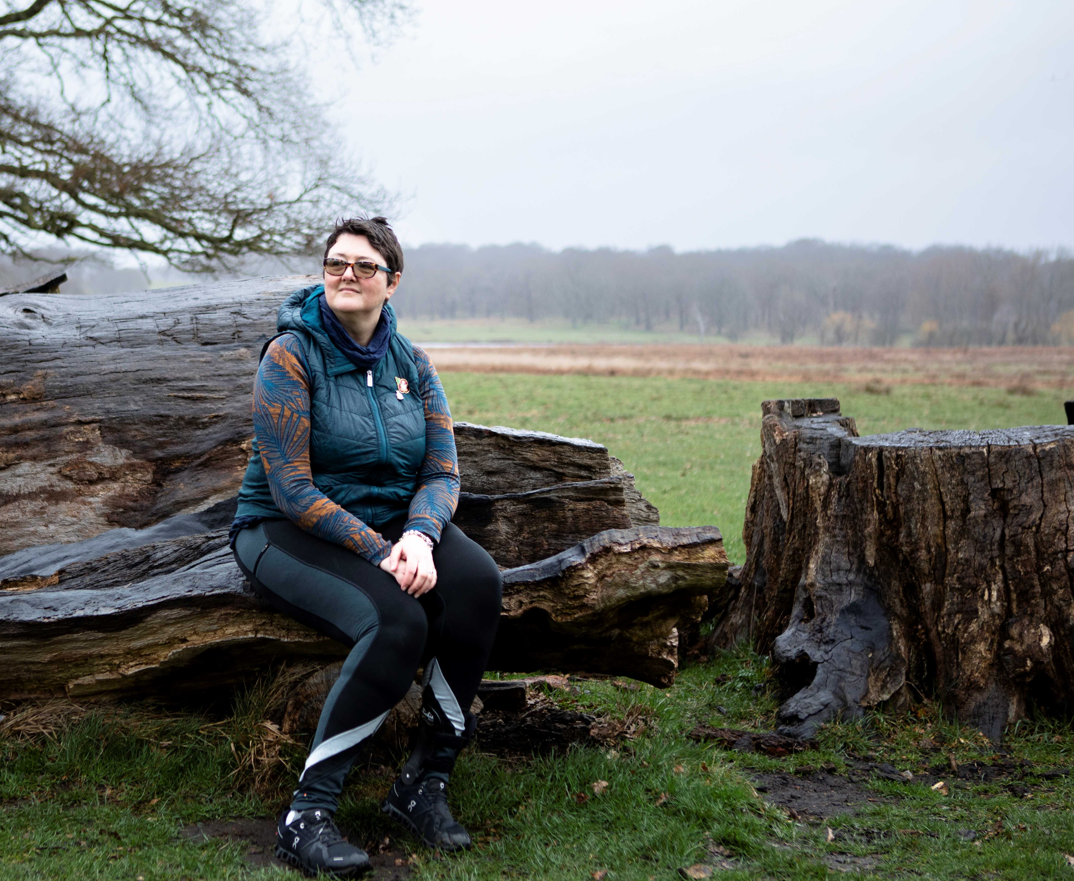
Op COURAGE national campaign

Slide 2
In this briefing….
What is Op COURAGE?
About the campaign
How you can help

Slide 3
What is Op COURAGE?
The veterans mental health and wellbeing service
For veterans, reservists and those with a leaving date from Service
Delivered by provider collaboratives on a regional footprint
www.nhs.uk/opcourage

Slide 4
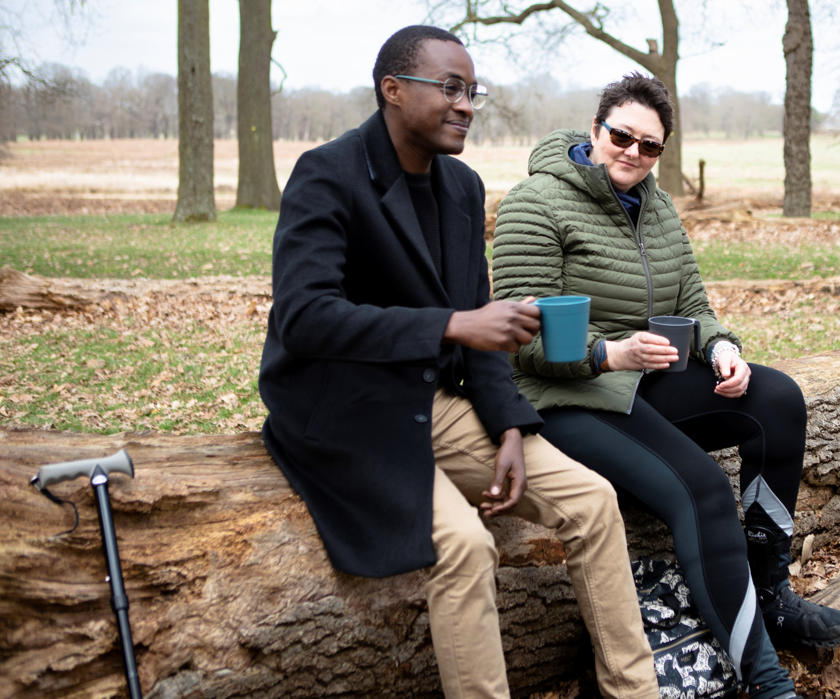
Op COURAGE can support with any mental health concern
Individuals can self refer or GP / charities / friends and family can also refer
Op COURAGE has supported nearly 30,000 veterans since 2017
Formerly three services: from 1 April 2023 Op COURAGE has been commissioned under a single service specification

Slide 5
Mental health and wellbeing
Ongoing, service attributable physical injury
Support pre and post prison custody
Multiple referral options
(including self referral)
Primary care referral only
Multiple referral options
(including self referral)

Slide 6
About the campaign
Features well known veteran JJ Chalmers talking to Denis, Debbie and Dom about their experience of leaving the Armed Forces and using the Op COURAGE service.
The concept of the film is ‘We’re in it together’ and features JJ and the veterans chatting over a brew.
Launches 9 January

Slide 7
About the campaign
Aim
To increase awareness of Op COURAGE and therefore a longer term increase in referrals
Target audience
Early service leavers
Commonwealth, Black and Asian veterans
Women
LGBT+
Veterans with experience of the justice system

Slide 8
How you can support
Download and use the campaign toolkit
On social media:
Schedule regular social media posts across different platforms
Engage (like or share) where you see posts from other NHS organisations

Slide 9
How you can support
Include a piece about Op COURAGE in your internal and external news – copy for you to use is included in the toolkit.
Blog post or news piece for your organisation’s website and intranet
Share the campaign with internal and external stakeholders encouraging them to get involved.

Slide 10
How you can support – NHS trusts
Encourage frontline staff to routinely ask if patients ‘have ever served in the Armed Forces’ and record in the patient’s notes / record
Is your NHS trust Veteran Aware accredited? – consider doing this via the Veterans Covenant Healthcare Alliance

Slide 11
How you can support – GP practices
Text patients to let them know about Op COURAGE and encourage them to let staff know if they have served in the Armed Forces
Encourage frontline staff to routinely ask if patients ‘have ever served in the Armed Forces and record in the patient’s notes / record
If your practice is not Veteran Friendly accredited – consider doing this via the RCGP

Slide 12
Sign up for the Armed Forces stakeholder brief
How you can support
Follow us
@NHSArmedForces
https://forms.office.com/e/yJUr1CGGzT

