Slide 1
Fire Safety
We have asked you to complete the Fire Online Training, which is important to keeping all staff, patients and visitors safe on-site.
These slides provide some brief supplementary information about Fire Safety at SFT.
Emergency number:
Key contacts:
Pete Dovey, Fire Safety Officer
Your local / departmental ‘Fire Warden’
2222

Slide 2
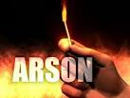
Most common causes of fire in Hospitals
• arson
• faulty or misused electrical equipment
• a build-up of rubbish or waste material (poor housekeeping)
• smoking
• cooking
• heating appliances placed near combustible/flammable materials
• unsafe storage and use of combustible/flammable materials
• hot processes

Slide 3
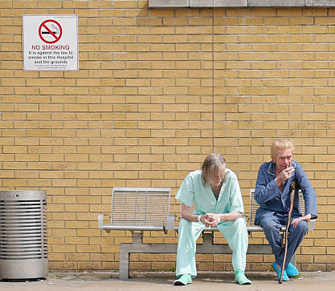
Potential Trust Fire Hazards
Smoking
Smoking is prohibited on the hospital grounds, be on the lookout for covert smoking.

Slide 4
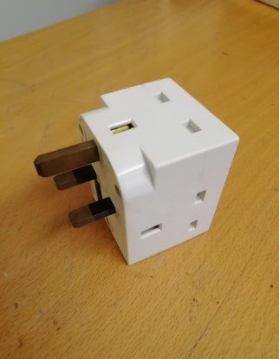
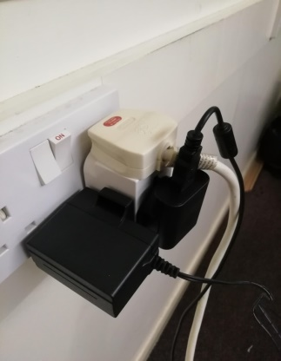
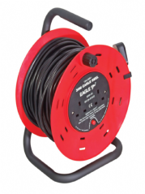
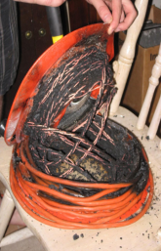
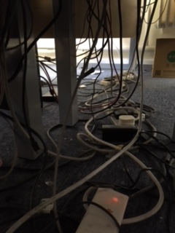
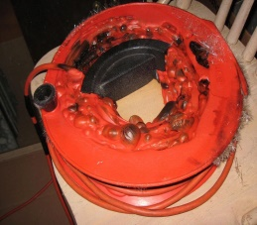
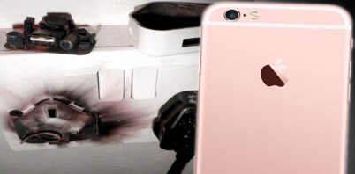
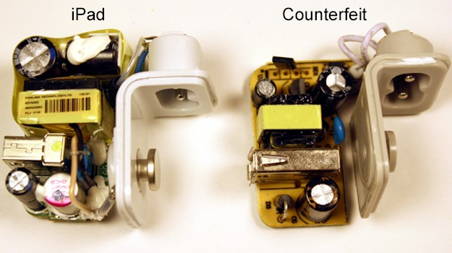
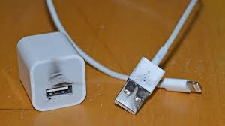
Cube plug adapters
Extension leads
Cube or block plug adapters are a fire risk and are not permitted to be used within the Trust.
Adaptors and chargers
Poorly made electronics such as phone chargers and adapters can cause electrocution or overheat and cause a fire. They have been blamed for a number of fires in recent years.
Counterfeit chargers may overheat, cause electric shocks and catch fire.

Slide 5
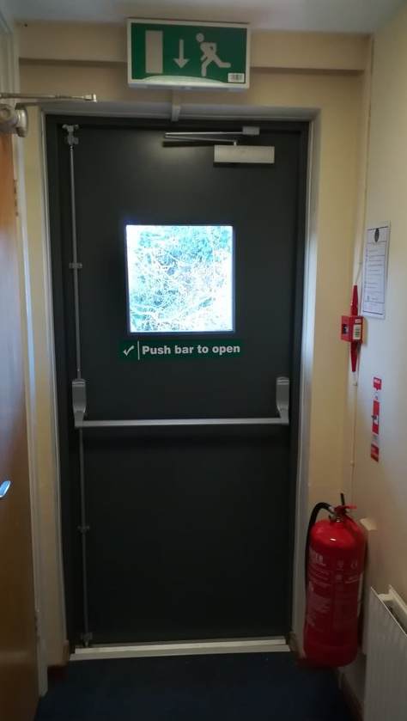
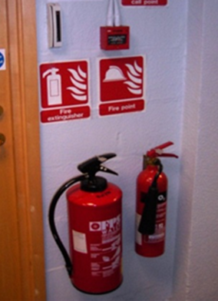
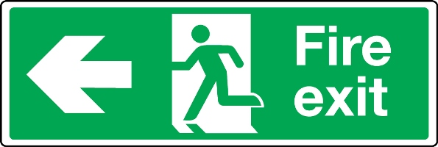
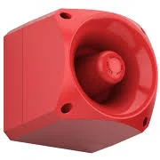
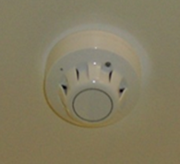
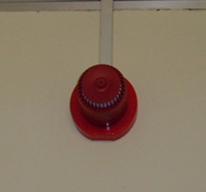
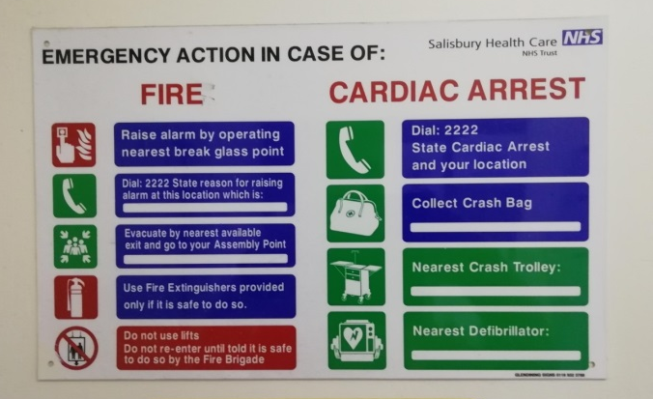
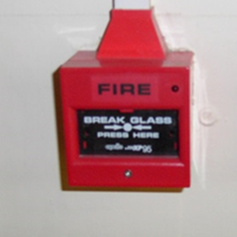
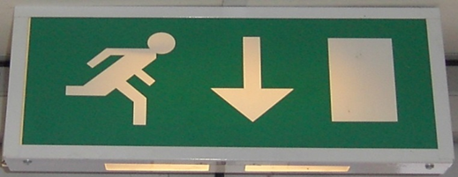
Escape routes at SFT

Slide 6
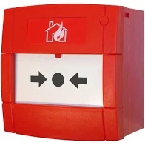
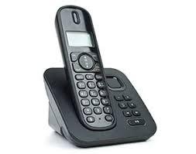
Action on Discovery of a Fire
If you discover a fire, immediately raise the alarm by breaking the nearest fire alarm call point.
Inform the hospital switchboard by telephoning 2222 to confirm there is a fire.
You may attempt to extinguish the fire with the appropriate extinguisher if the fire is small and if it is safe to do so, do not put yourself or others at risk.

Slide 7
Action on hearing the alarm
Do you know the sound of the continuous alarm?
Do you know the sound of the intermittent alarm?
Click here to hear the alarm
Click here to hear the alarm

Slide 8
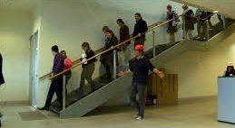
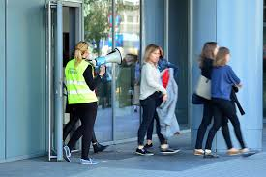
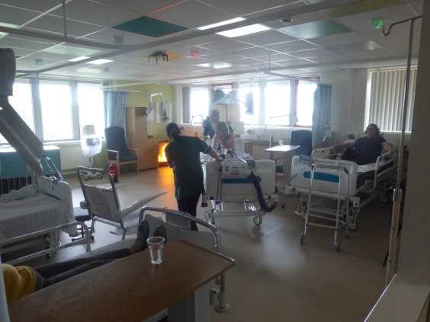
Fire Alarm Activation
Continuous sounding of the alarm means that everyone in non-ward areas should evacuate in those buildings.
Continuous sounding of the alarm in a ward means evacuation should be instigated if a fire is confirmed.
MAKE SURE YOU LEARN ABOUT YOUR
LOCAL EVACUATION PLAN WHEN YOU START IN YOUR DEPARTMENT.

Slide 9
Thank you for your time

