Slide 1
OD & People Directorate
Additional Information

Slide 2
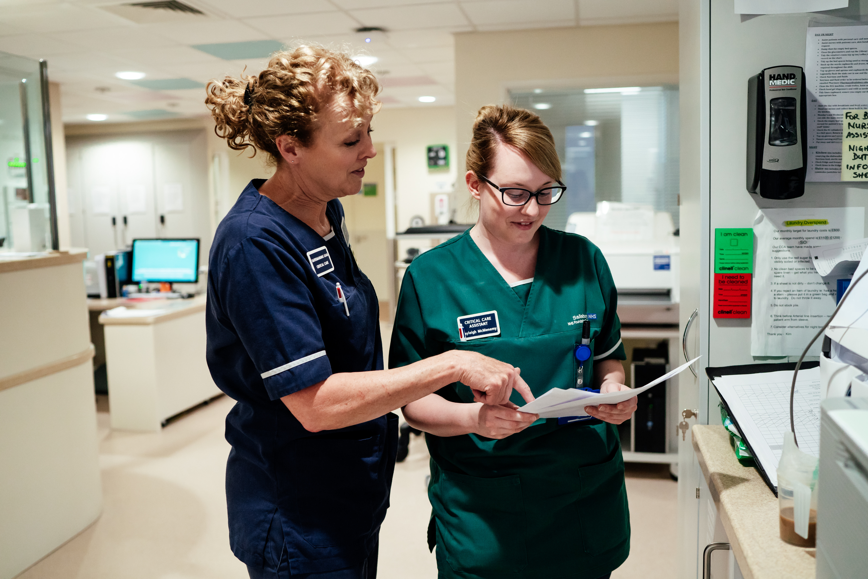
Content
Pay Procedures
NHS Pension Scheme
Employee Self-Service/Manager Self Service
Policies and Procedures
100 day questionnaire
OD & People contact (HR)
Useful contact numbers
Trust’s social media information

Slide 3
Pay procedures
All employees, with the exception of Nurse (RN and HCA) and Medical Bank workers are paid monthly.
Salary payments are electronic, straight into a bank account and are made on 2nd to last working day of the month.
Salary payment date is slightly earlier at Christmas.
Pay slips are electronic and viewable via employee self service (download app or via website).
Bank (RN, HCA and Medical) workers are paid weekly.

Slide 4
NHS Pension Scheme
As an NHS employee when you commence employment with the Trust you will be automatically enrolled into the NHS Pension Scheme, or if you are not eligible to join the NHS Scheme you will be enrolled in the alternative scheme, National Employment Savings Trust (NEST).
Unfortunately you will not be eligible to join the NHS Pension Scheme in the following circumstances:-
- You are already in receipt of an NHS Pension.
- You are in receipt of an NHS Tier 2 Ill Health Pension
- You have reached maximum NHS Pensionable Service.
- You are over 75.
- You hold an honorary appointment
Further information on the NHS Pension scheme can be found here
https://www.nhsbsa.nhs.uk/nhs-pensions
If you wish to opt out of the pension scheme you will need to complete for SD502, print and bring along with you on your first day.
Please use this link to find out more about leaving the pension scheme
https://www.nhsbsa.nhs.uk/member-hub/leaving-or-taking-break-scheme
Alternative Scheme (NEST)
If you are enrolled into NEST and wish to opt out the contact details are www.nestpensions.org.uk or telephone 0300 020 0090.
However, this cannot be done until you have received your NEST membership pack which can take up to 8 weeks.
If you have any further queries eg transferring pensions into the NHS scheme please contact a member of our Pensions Team on 01722 336262 ext 2794.

Slide 5
Employee Self-Service/Manager Self Service
Employee Self Service
Update your personal details
View your payslips online in advance of payday
Access your Total Reward Statement including pension details
Do all of the above (and more) 24/7 from your Phone or Smart Device
Now available to all staff
Manager Self Service
Manager will update your employment record using manager self service
Work
App 24/7
Self help guides available at http://intranet/website/staff/howdoi/esrselfserviceguides/index.asp
Questions to sft.ess.support@nhs.net
Information on how to find your user name and password to access your ESR account will be provided separately

Slide 6
Policies and Procedures
The Trust has a wide variety of policies and procedures in place on a number of subjects including disciplinary, grievance, annual leave, flexible working.
To view all of the policies and procedures please click on the link https://viewer.microguide.global/SALIS/ODP
Your Line Manager is also able to answer questions and queries you may have.

Slide 7
100 day questionnaire
When you have completed 100 days we will send you a link to a survey to complete (it will be sent to your work and home email)
Areas you’ll be asked about include recruitment process, induction, first impressions, being welcomed into the Trust, what attracted you to apply.
Opportunity to shape the future experience of new employees joining the Trust
You’ve just been through it, so please be honest.

Slide 8
OD & People Directorate (HR)
People Operations Team sft.peopleops@nhs.net
Medical Workforce sft.medicalhr@nhs.net
Recruitment sft.recruitment@nhs.net
ESR Support Team sft.ess.support@nhs.net

Slide 9
Useful contact numbers
Department | Contact number/extension
Main Hospital Number | 01722 336262
Salaries and Wages - for any salary related queries such as, payment/employee number/tax | X 2046/2795
Pensions | X 2794
Recruitment - for any information about recruitment within the Trust | X 5585
People Business Team (HR) - employment queries | X 5584
Occupational Health COVID hotline | X 5241 X 4143
Facilities - ID badge, car parking, Salisbury REDS card ‘the key’ | X 2598

Slide 10
Follow the Trust on the following to be kept up to date with what’s going on:
@SDHRecruitment – the Recruitment Services Team
@SalisburyNHS – the Main Hospital Twitter page
@salisburydistricthospital – the Main Hospital Facebook Page
Salisbury NHS Foundation Trust – The Hospital’s LinkedIn page

