Slide 1
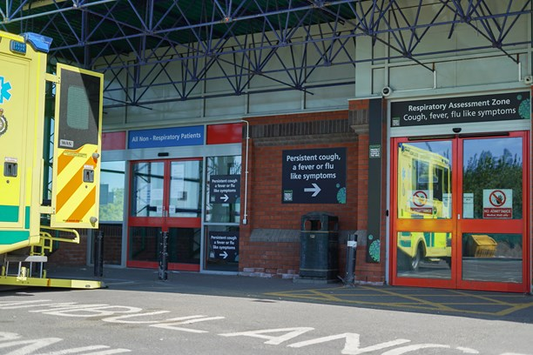
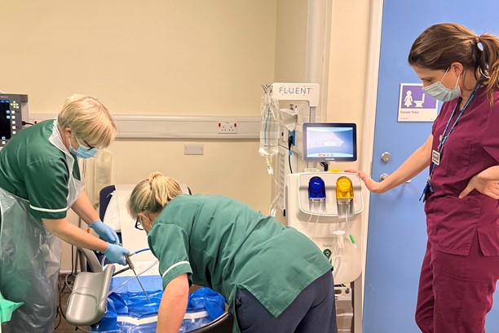
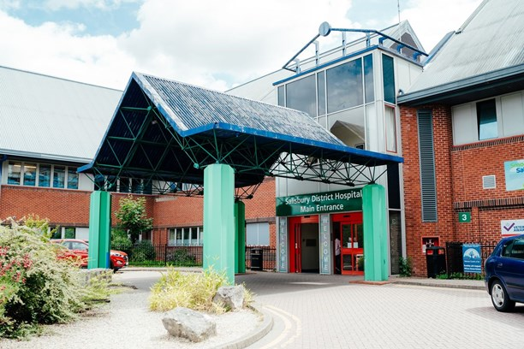
AGM Agenda – 14th October Lecture Theatre, Education Department, Level 5
14:15 – Arrival, Tea and Coffee available
15:00 - Introduction and welcome
Dr Nick Marsden Chair
15:10 - Annual Report 2021/22
Stacey Hunter Chief Executive
15:30 - Annual Accounts and Audit Opinion
Mark Ellis Chief Finance Officer
15:40 - Clinical Presentation – Orthopaedics/ Day Surgery Procedures
Mr Leonidas Vachsevanos, Orthopaedic Consultant/ Mr Ivor Vanhegan, Orthopaedic Consultant/ Mr Jonathan Quayle, Orthopaedic Consultant
16:00 - Clinical Presentation - Veteran Surgery
Miss Alexandra Crick, Plastic and Reconstructive Surgery Consultant
16:20: - Council of Governors Report to Members
Lucinda Herklots Lead Governor
16:30 – Questions and Answer Session
Dr Nick Marsden Chair/ Executives
17:00 – Finish

